Slide 1
Boxing Wearable
Andrew Pham

Slide 2
Introduction
Cardio Boxing
Non Contact
Great Exercise
Great Practice
The Wearable
SensorTile on Wrist
Over Boxing Glove
Data Streaming
Coaching

Slide 3
Specific Aims
Punching Mechanics
Type
Velocity
Quickness
Coaching Aid and Stand-In

Slide 4
Methods
SensorTile
Accelerometer determines power
Gyroscope Determines Type
Simple scoring for coaching and gaming
Modes
Detect
Prompt
Game

Slide 5
Defining Punches
Cross: fist rotation, full travel time, hard
Hook: no rotation, full travel time, hard
Jab: small rotation, quick, light
Examples

Slide 6
Detection Examples
Boxer punches and the device detects punch data
Shadowboxing
Solid!
Bag Work
Issues
Why?

Slide 7
Prompted Example
Boxer is given a prompt
Punches are recorded
Boxer is given a grade

Slide 8
COACHING Example
Boxer’s punches are recorded
Data is summarized after one minute
Boxer is given a grade

Slide 9
The Real Issue
Punching Detection
Accuracy Rate
TODO % accurate shadowboxing
TODO% accurate boxing vs bag
Can Machine Learning Help?

Slide 10
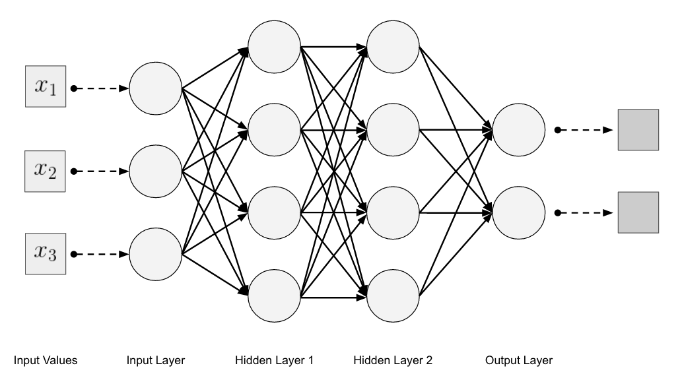
Machine Learning punches
Classification Problem
Inputs
3D ACC
3D GYRO
Quickness Timer
Features
Timing and Rotation
Training and Backprop
Test set and outputs

Slide 11
Conclusion
Takeaways
What’s Next?
Wireless
Built into glove
Impact Velocity
Coaching
KNES & Medicine

